Slide 1
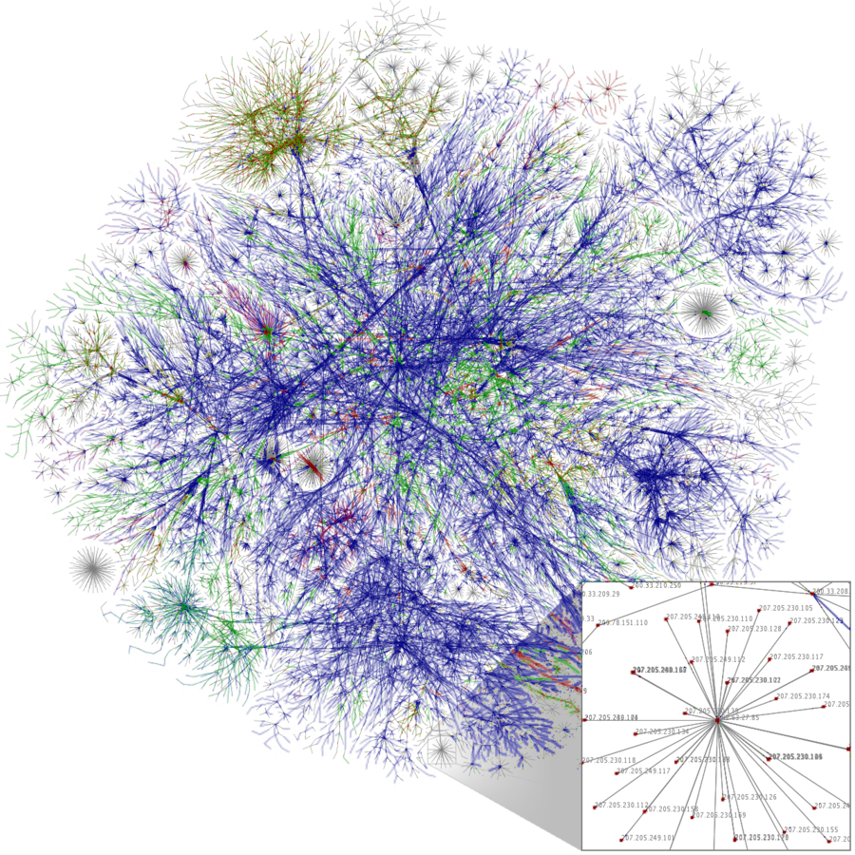
What is the Internet
Notes:
*

Slide 2
What is the Internet
The Internet (capital ‘I’) is the global public network of independent and autonomous networks that are governed by the Internet Protocol Suite.
A partial map of the Internet based on 2005 data produced by the Opte project. Each line is drawn between nodes or addresses on the Internet. The colors represent different top-level domains, such as com, edu and org. Click the map to zoom in.

Slide 3
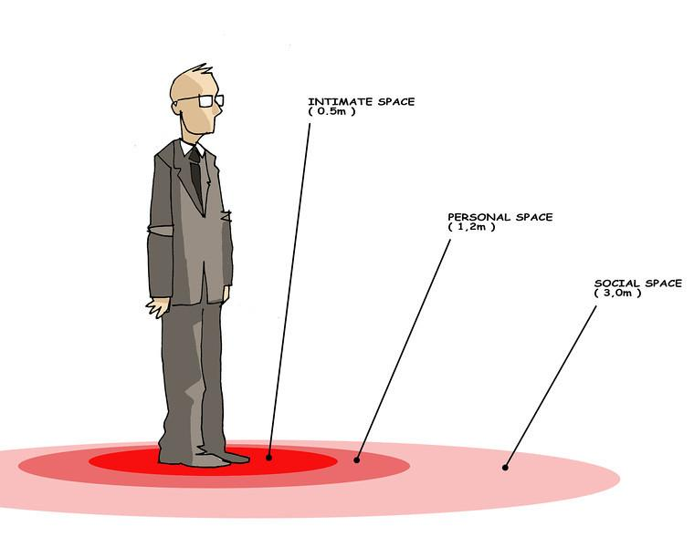
Communication Protocol
A protocol is a system of rules that govern the behavior of some system.
Diplomatic protocol or etiquette governs how diplomats should behave.

Slide 4
Wikipedia Definition
The Internet is a global system of interconnected computer networks that use the Internet protocol suite (TCP/IP) to communicate.

Slide 5
Wikipedia Definition
The Internet is a global system of interconnected computer networks that use the Internet protocol suite (TCP/IP) to communicate.
Network of networks - Millions of private, public, academic, business, and government networks, linked by a broad array of electronic, wireless, and optical networking technologies.

Slide 6
Wikipedia Definition
The Internet is a global system of interconnected computer networks that use the Internet protocol suite (TCP/IP) to communicate.
Network of networks - Millions of private, public, academic, business, and government networks, linked by a broad array of electronic, wireless, and optical networking technologies.
The Internet includes:
inter-linked hypertext documents and applications of the World Wide Web (WWW)
the infrastructure to support email
peer-to-peer networks for file sharing and telephony.

Slide 7




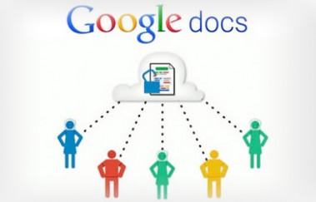

Applications for Collaboration

Slide 8
The Internet and the WWW
Notes:
*

Slide 9
A Common Misconception
The World Wide Web (WWW) is NOT the same as the Internet.
Internet != WWW

Slide 10
A Common Misconception
The World Wide Web (WWW) is NOT the same as the Internet.
Internet != WWW
The WWW is an application that runs on the Internet.

Slide 11
A Common Misconception
The World Wide Web (WWW) is NOT the same as the Internet.
Internet != WWW
The WWW is an application that runs on the Internet.
The WWW is a collection of documents, images, and resources that are stored on the Internet.

Slide 12
A Common Misconception
The World Wide Web (WWW) is NOT the same as the Internet.
Internet != WWW
The WWW is an application that runs on the Internet.
The WWW is a collection of documents, images, and resources that are stored on the Internet.
The WWW is NOT a network.

Slide 13
WWW is an Application Service
The WWW is an application service that runs on the Internet.

Slide 14
WWW is an Application Service
The WWW is an application service that runs on the Internet.
It is based on the HyperText Transfer Protocol (HTTP)

Slide 15
WWW is an Application Service
The WWW is an application service that runs on the Internet.
It is based on the HyperText Transfer Protocol (HTTP)
Internet applications are governed by protocols

Slide 16
WWW is an Application Service
The WWW is an application service that runs on the Internet.
It is based on the HyperText Transfer Protocol (HTTP)
Internet applications are governed by protocols
E-mail: Simple Mail Transfer Protocol (SMTP) or Post Office Protocol (POP)
File transfer: File Transfer Protocol (FTP)
Instant Messaging: Internet Relay Chat (IRC)
Telephony: Voice Over IP (VoIP)

Slide 17
WWW is an Application Service
The WWW is an application service that runs on the Internet.
It is based on the HyperText Transfer Protocol (HTTP)
Internet applications are governed by protocols
E-mail: Simple Mail Transfer Protocol (SMTP) or Post Office Protocol (POP)
File transfer: File Transfer Protocol (FTP)
Instant Messaging: Internet Relay Chat (IRC)
Telephony: Voice Over IP (VoIP)
These are distributed applications because they run on a network, not on a single computer.

Slide 18

Sir Tim Berners-Lee
The WWW was invented by Tim Berners-Lee.

Slide 19
Sir Tim Berners-Lee
The WWW was invented by Tim Berners-Lee.
Who, instead of patenting his invention, made his idea freely available without royalties.

Slide 20
Sir Tim Berners-Lee
The WWW was invented by Tim Berners-Lee.
Who, instead of patenting his invention, made his idea freely available without royalties.
In his view, the WWW brought the Internet to a higher level of abstraction.

Slide 21
Sir Tim Berners-Lee
The WWW was invented by Tim Berners-Lee.
Who, instead of patenting his invention, made his idea freely available without royalties.
In his view, the WWW brought the Internet to a higher level of abstraction.
"I just had to take the hypertext idea and connect it to the Transmission Control Protocol and domain name system ideas and—ta-da!—the World Wide Web ... Creating the web was really an act of desperation, because the situation without it was very difficult when I was working at CERN later. Most of the technology involved in the web, like the hypertext, like the Internet, multifont text objects, had all been designed already. I just had to put them together. It was a step of generalising, going to a higher level of abstraction, thinking about all the documentation systems out there as being possibly part of a larger imaginary documentation system."

Slide 22
Open Standards
HTTP is one of many examples of the open standards that characterize the Internet.
Why open?
“The Internet is fundamentally based on the existence of open, non-proprietary standards. They are key to allowing devices, services, and applications to work together across a wide and dispersed network of networks.”
-- Internet Society

Slide 23
Open Standards
Open standards are not proprietary -- i.e., not owned by any corporation.

Slide 24
Open Standards
Open standards are not proprietary -- i.e., not owned by any corporation.
Created and managed through a public process by open international communities such as the International Engineering Task Force (IETF) and the World Wide Web Consortium (W3C).

Slide 25


Open Standards
Open standards are not proprietary -- i.e., not owned by any corporation.
Created and managed through a public process by open international communities such as the International Engineering Task Force (IETF) and the World Wide Web Consortium (W3C).
Standard - Draft
Standard - Final
Public Comment
Revisions
Notes:
EK 6.2.2E Open standards fuel the growth of the Internet.

Slide 26
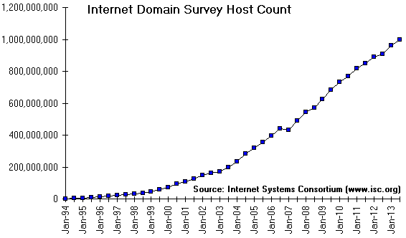
Growth of the Internet
The Internet has grown exponentially since its inception in 1984 (this graph shows since 1994).

